Slide 1
Analysis of Student Alcohol Consumption
By: - Rohit K.
Abhinav S.

Slide 2
Contents
Dataset
Scope
Exploratory Data Analysis(EDA)
Models
Conclusion

Slide 3
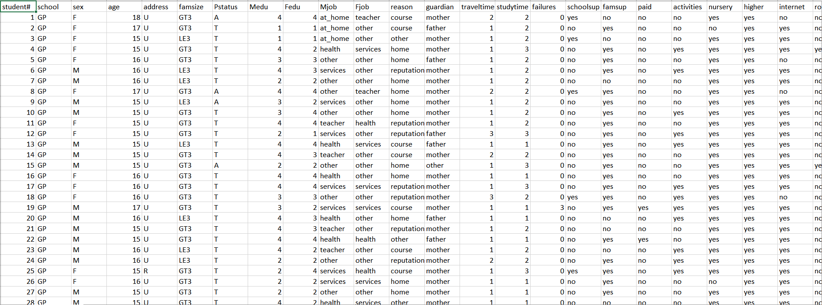
Dataset
Approximately 40 variables collected from 2 different High schools (Categorical, Numerical and Binary)

Slide 4
Scope
Target Variables:
Grades
Alcohol Consumption
Weekday Alcohol Consumption
Weekend Alcohol Consumption

Slide 5
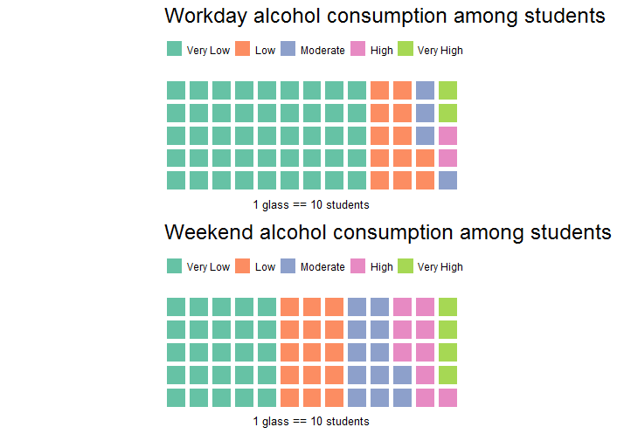
Exploratory Data Analysis

Slide 6
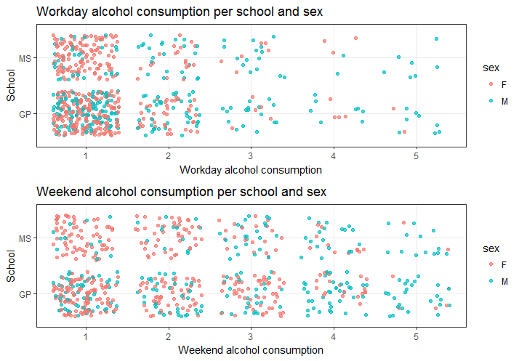
Continued….

Slide 7
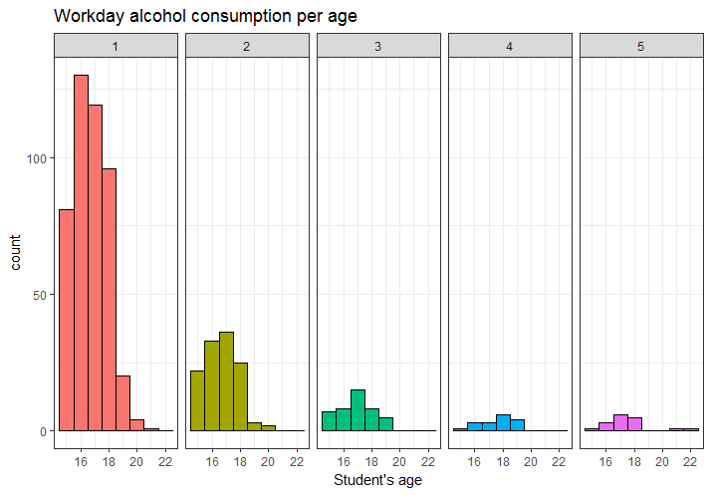
Continued….

Slide 8
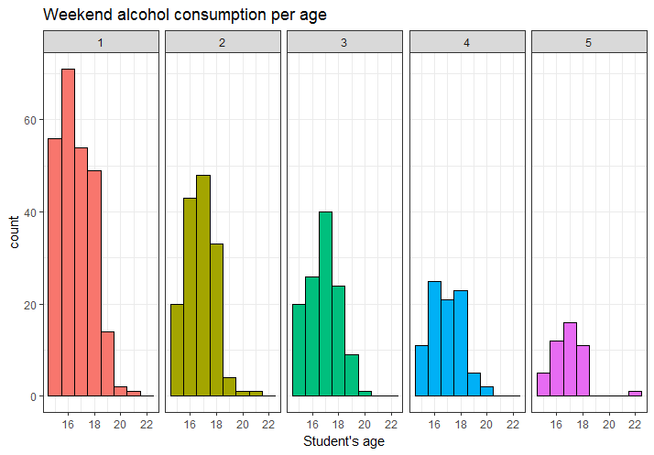
Continued….

Slide 9
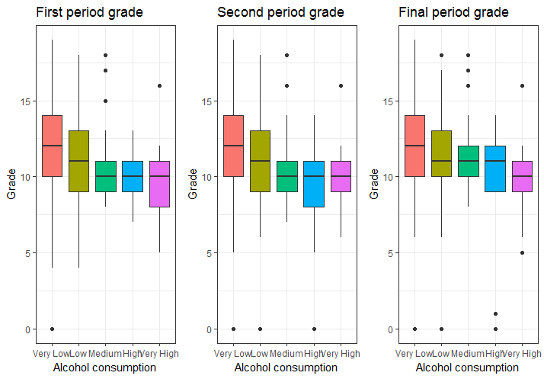
Continued….
Workday alcohol Consumption VS Grades in each period.

Slide 10
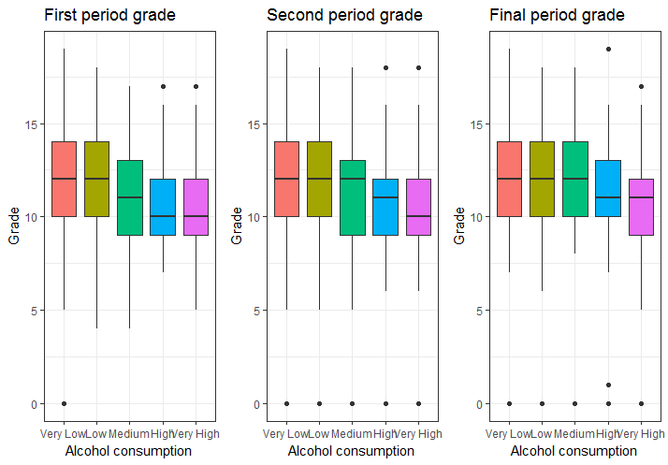
Continued….
Weekend alcohol Consumption VS Grades in each period.

Slide 11
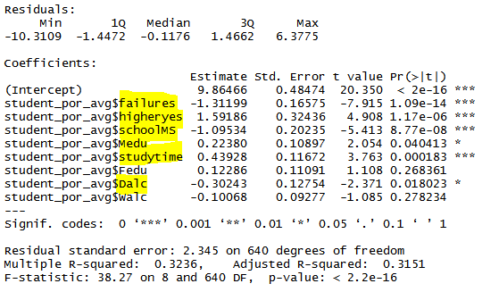
Model(Grade Analysis)

Slide 12
Results
The inference drawn from the analysis performed on Average grade were:-
Failures and Average Grades –Negatively related
SchoolMS and Average Grades – Negatively related
HigherYes and Average Grades – Positively related
StudyTime and Averarge Grades – Positively Related
Mother’s Education and Average Grades – Positively related
Weekday Alcohol Consumption and Average Grades – Negatively related

Slide 13
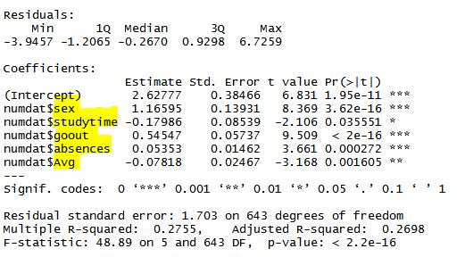
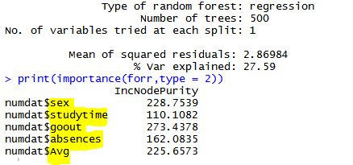
Model(Total Alcohol Consumption)
Linear Regression
Random Forest

Slide 14
Results
Both the models give us the same predictors and almost the same accuracy. The inferences drawn from the Analysis of Total Alcohol Consumption are:-
GoOut and Total Alcohol consumption – Positively related
Sex and Total Alcohol consumption - Highly related
Average Grades and Total Alcohol consumption – Negatively related
Absences and Total Alcohol consumption – Positively related
StudyTime and Total Alcohol consumption - Negatively related

Slide 15
Conclusion
So by analysis of both the target variables we conclude that there is a strong, negative relationship between Alcohol consumption and Average Grades as Average grade is the 3rd best predictor for Total Alcohol consumption and Weekday Alcohol consumption was the 6th best predictor of Average Grades.

